Slide 1


Getting started with artificial intelligence
Notes:
During this session we’ll cover:
what AI is
how you may already be using it without knowing
AI tools that could help you in everyday life
what we need to think about when using AI

Slide 2
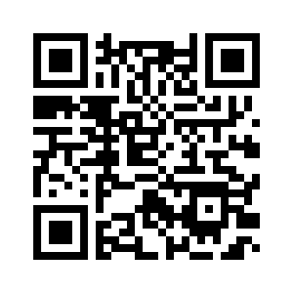
Survey
goodthingsfoundation.tfaforms.net/254
Notes:
Before we start, please open this survey and answer question 1 only.
We’ll revisit the survey and answer the other questions at the end of the session.
This will help us understand the effectiveness of the session and make any improvements as needed.
goodthingsfoundation.tfaforms.net/254

Slide 3
How do you feel about
artificial intelligence?
Notes:
When you hear the term artificial intelligence (or AI) what does it make you think about? How does it make you feel?
Put your hand up if you’d like to share with the group.
Hopefully we’ll address some of these points in this session.

Slide 4
What is artificial intelligence?
It’s a way that computers process and
learn from huge amounts of information to make connections.
It can help computers to do things quicker.
Notes:
AI has been around for quite a while. It’s been working in the background in many of the ways we connect to the internet and carry out activities online.
It is used in other common applications, such as weather forecasting and sport (eg checking if a footballer is offside).
Some of the things AI is used for might by surprising, like creating art, driving cars, or diagnosing illnesses.

Slide 5
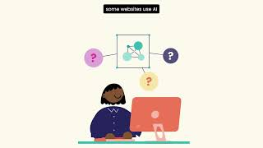
Introduction to AI
Notes:
Let’s hear a bit more about AI in this video.
youtu.be/vBePahzcXfc

Slide 6
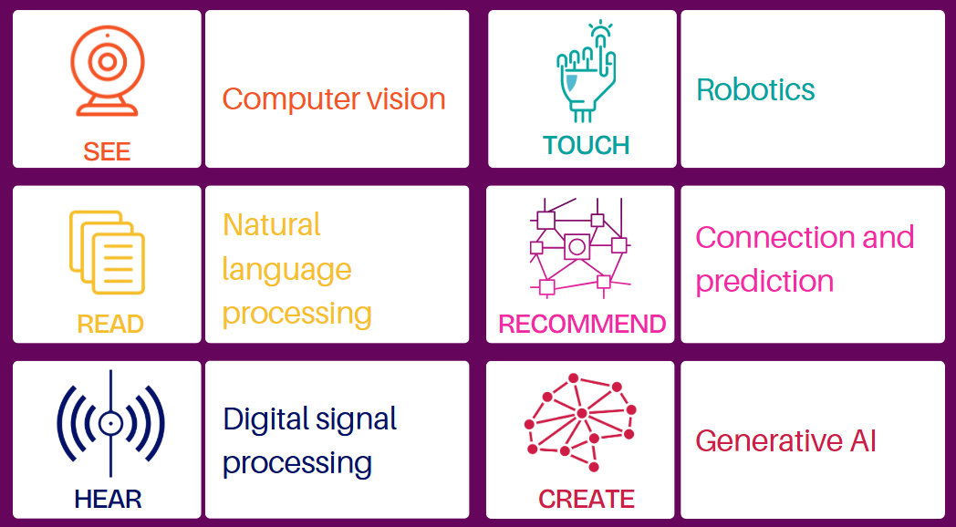
Types of AI
Notes:
Now, let’s take a look at the various types of AI.
Although we often use the term "AI" as a catch-all phrase, there are actually different types of artificial intelligence, each with its own unique capabilities.
I find it helpful to consider these in human terms: how AI systems can see, read, hear, touch, recommend, and create things.

Slide 7
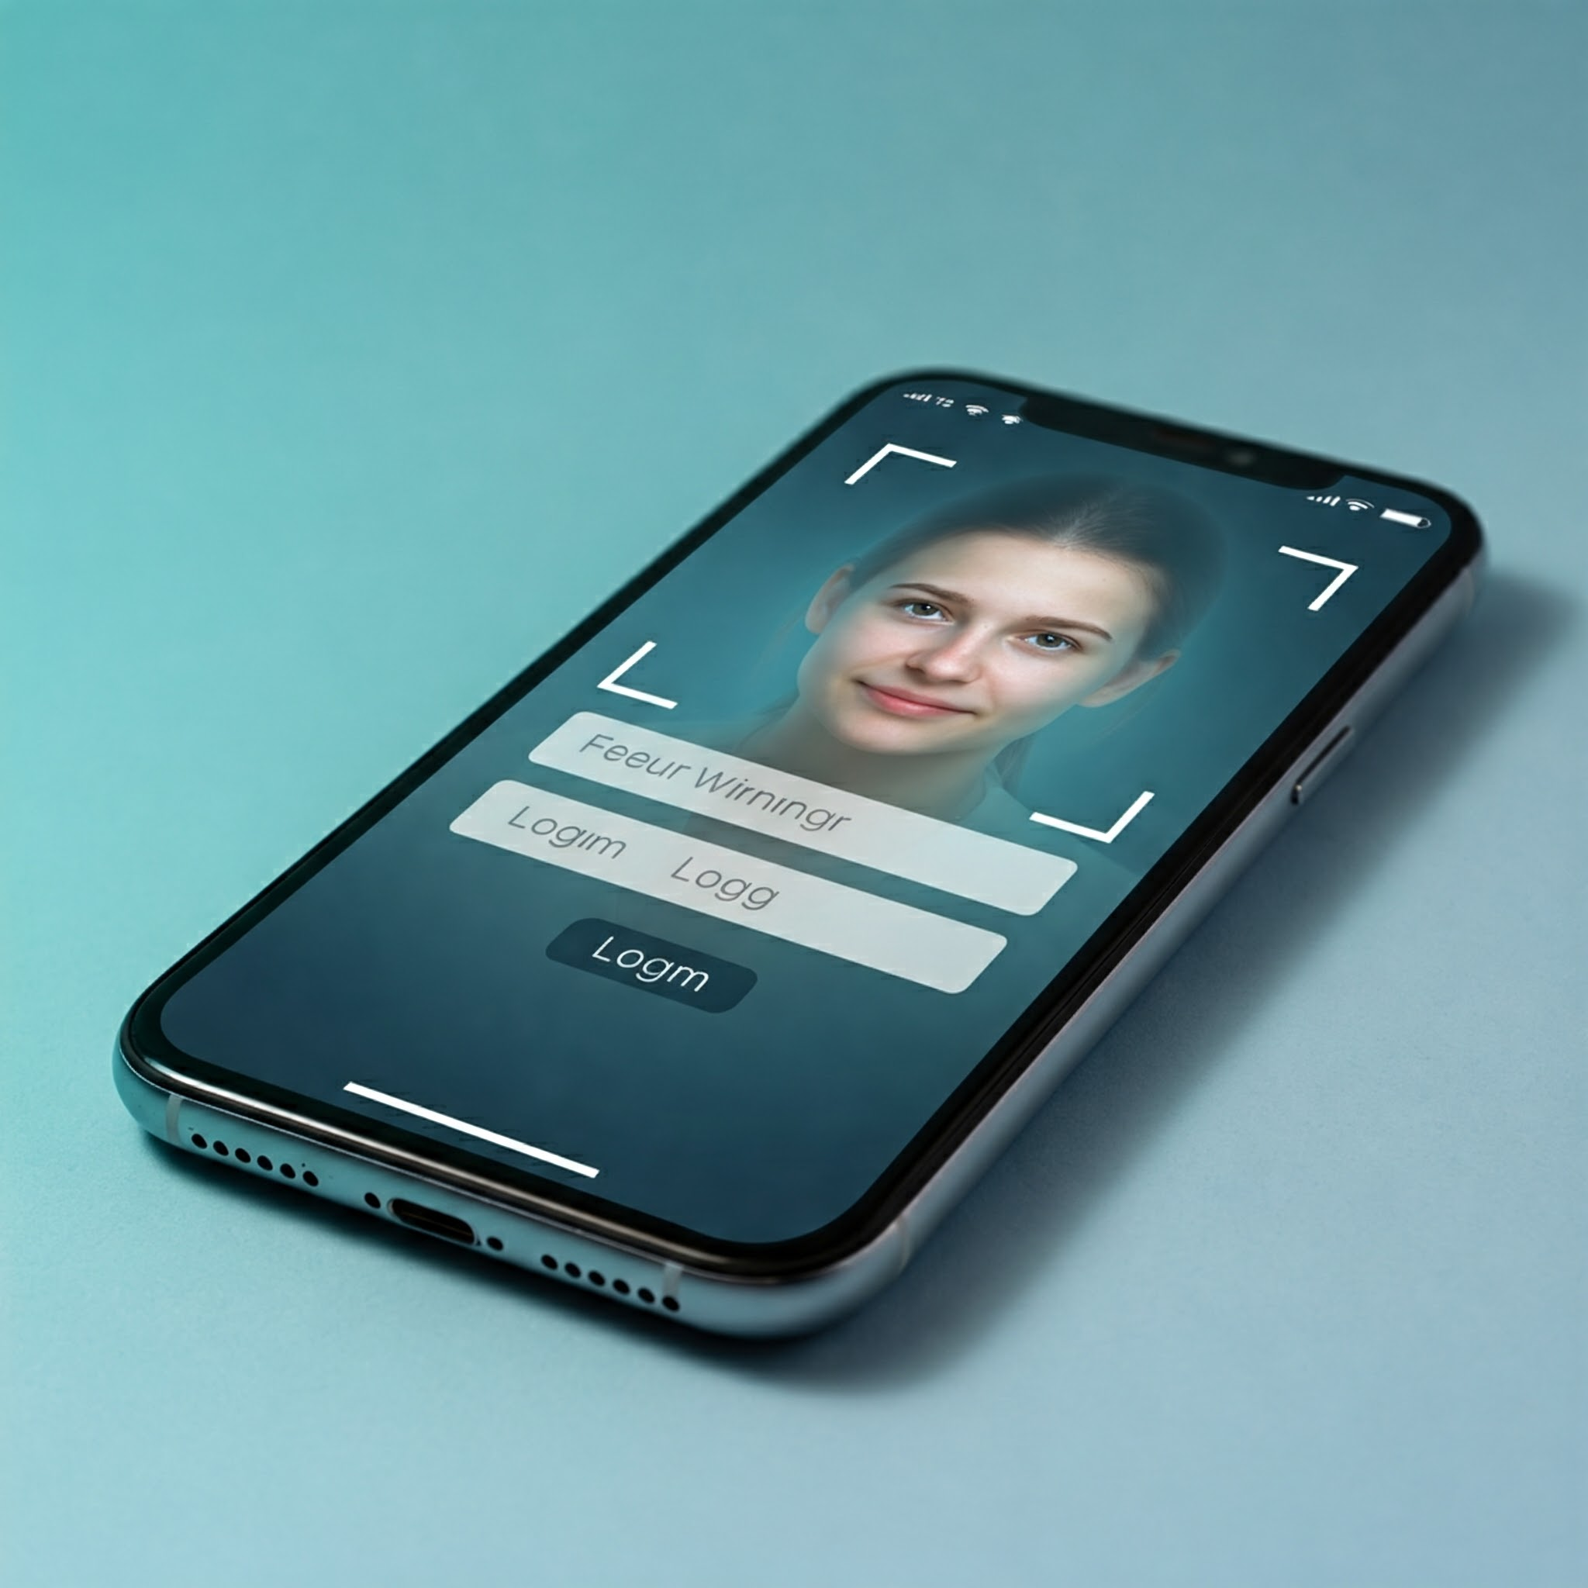
See
Computer vision
Facial recognition
Autonomous navigation
Medical imaging
Notes:
Some forms of AI are capable of understanding and interpreting visual information. They can analyse images, videos, and other visual inputs to extract valuable details. This type of AI is used in various applications, such as:
when you unlock your phone using facial recognition technology.
For driverless cars, where AI helps interpret the environment and make driving decisions.
For detecting tiny tumors that are invisible to the human eye.
Another example is Google Lens, which can analyse an image (whether it's from a website or a photograph you've taken) on your phone and perform a reverse search to provide information about what it's seeing. For instance, it can identify an item in a shop and tell you where else you can buy it, or recognise a flower or animal you come across and tell you the name.

Slide 8

Read
Natural language processing
Language translation
Chatbots
Image by Teresa Berndtsson
Better Images of AI
Notes:
Other types of AI are able to use natural language processing, to understand, interpret, and respond to human language.
This type of AI is used for language translation, as seen in tools like Google Translate (which we'll be using later) and Microsoft Translator.
It is also employed in chatbots, where we type our questions into customer service bots on websites. The AI in these chatbots recognise the words we've typed and provide us with answers.

Slide 9
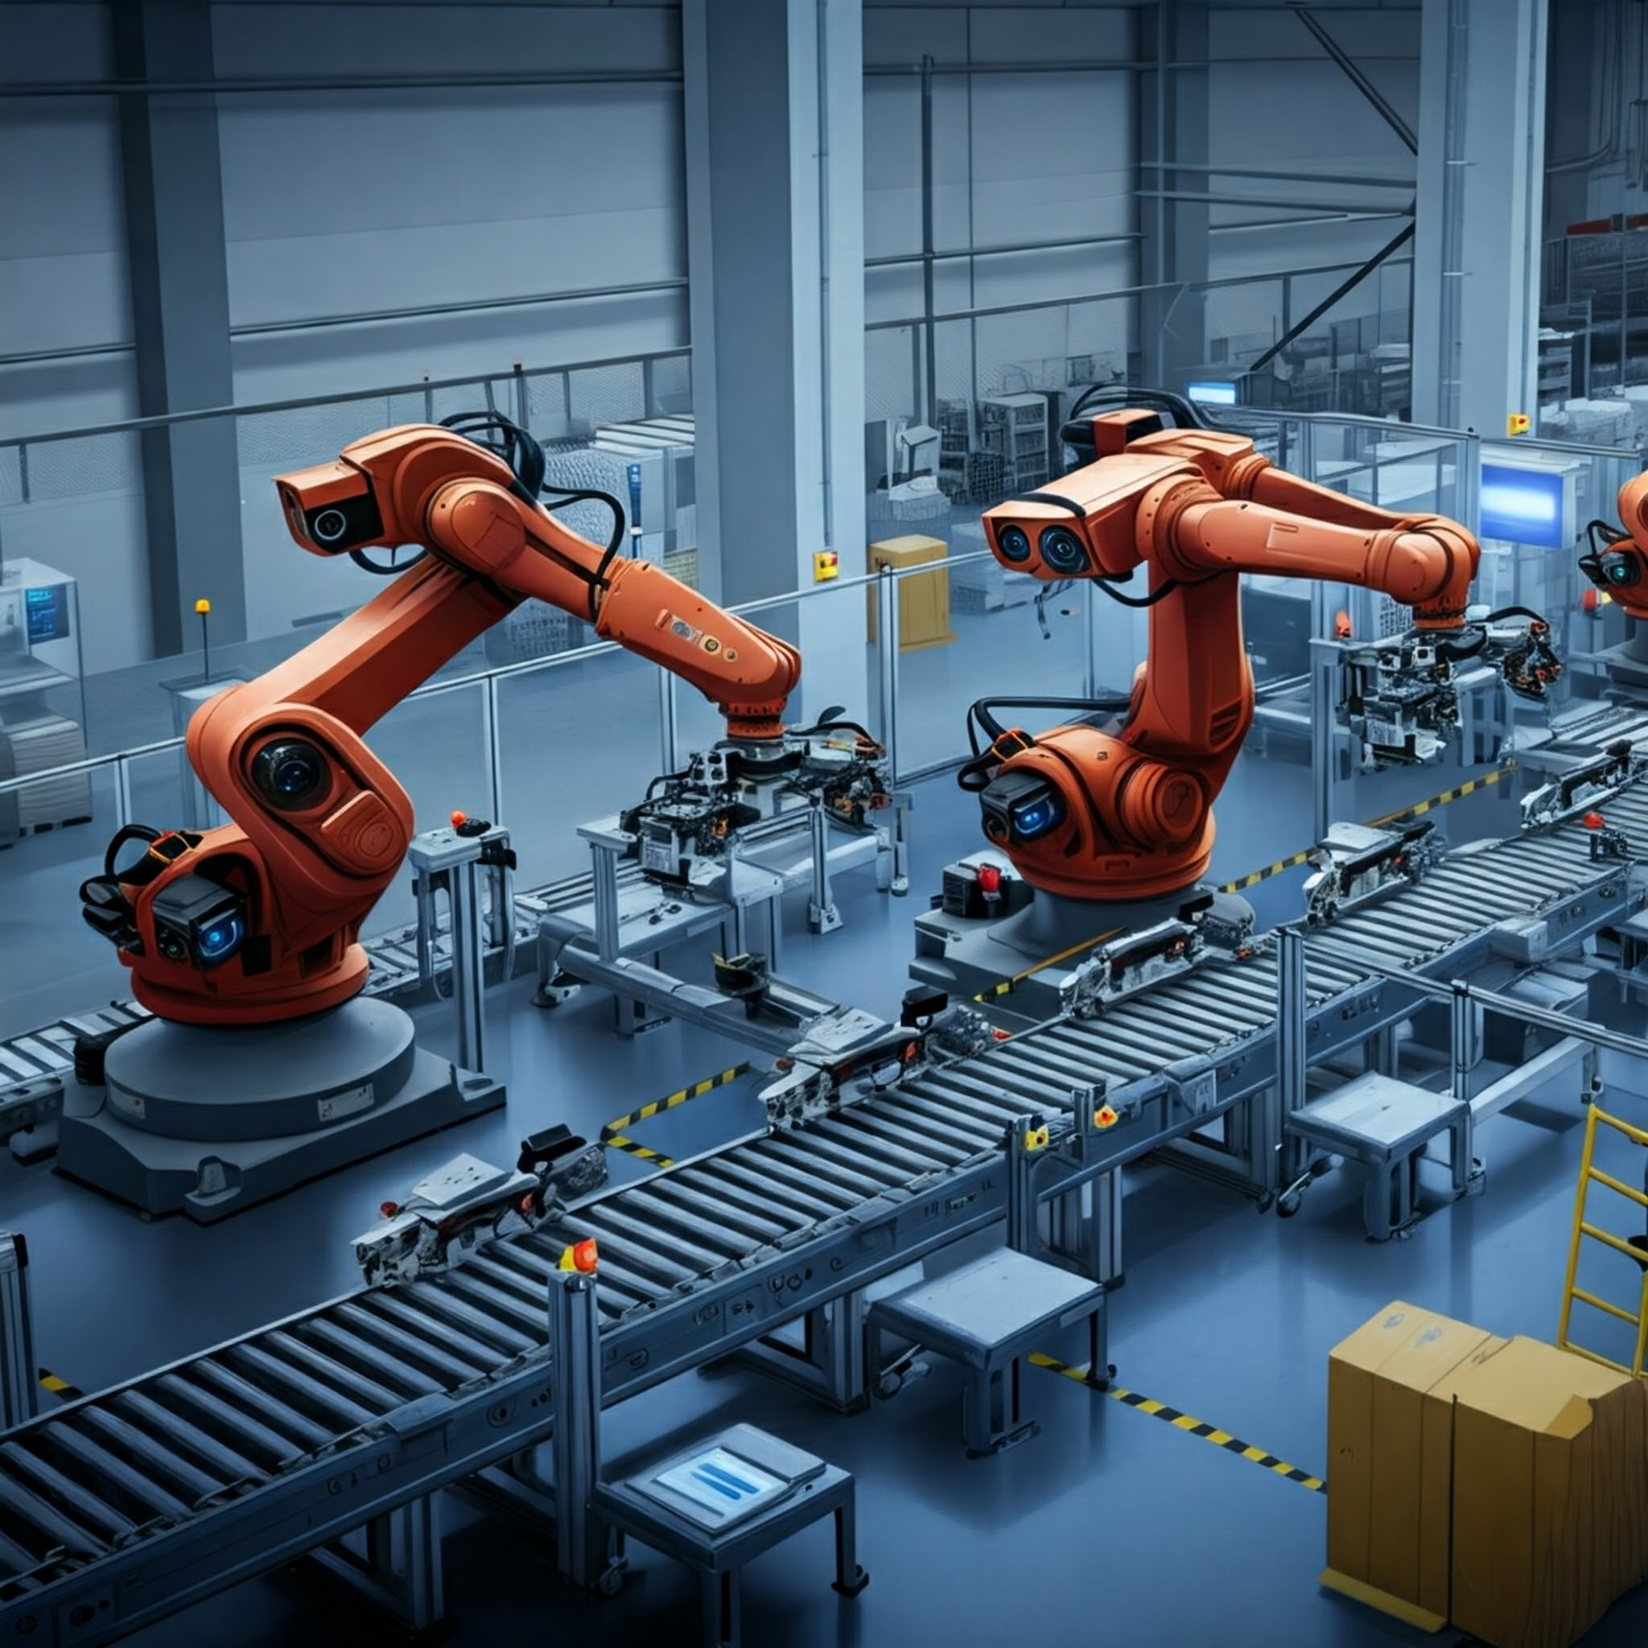
Touch
Robotics
Manufacturing
Healthcare
Agriculture
Notes:
Robotics is likely the most recognised aspect of AI, involving machines designed to carry out manual tasks traditionally performed by humans.
This type of AI is commonly used in various industries:
In manufacturing on assembly lines and for tasks such as welding and painting.
In healthcare to assist surgeons with precision and performing minimally invasive procedures.
In agriculture for planting, harvesting, and monitoring crops.

Slide 10


Make connections
Predictive
Entertainment
Online shopping
Fraud/spam detection
Image by Comuzi / © BBC
Better Images of AI
Notes:
Some types AI can use a range of information inputs and find/identify connections to make recommendations or predictions.
This type of AI is being used when streaming services like Netflix or iPlayer recommend other shows or films we might like based on what we have already watched. Also when online shops recommend other items we might like, based on what we have previously bought.
It’s also used for fraud / spam detection where banks monitor transactions to identify ones that could indicate fraudulent activity and in our email services which filter our incoming mail to identify possible scam emails.

Slide 11
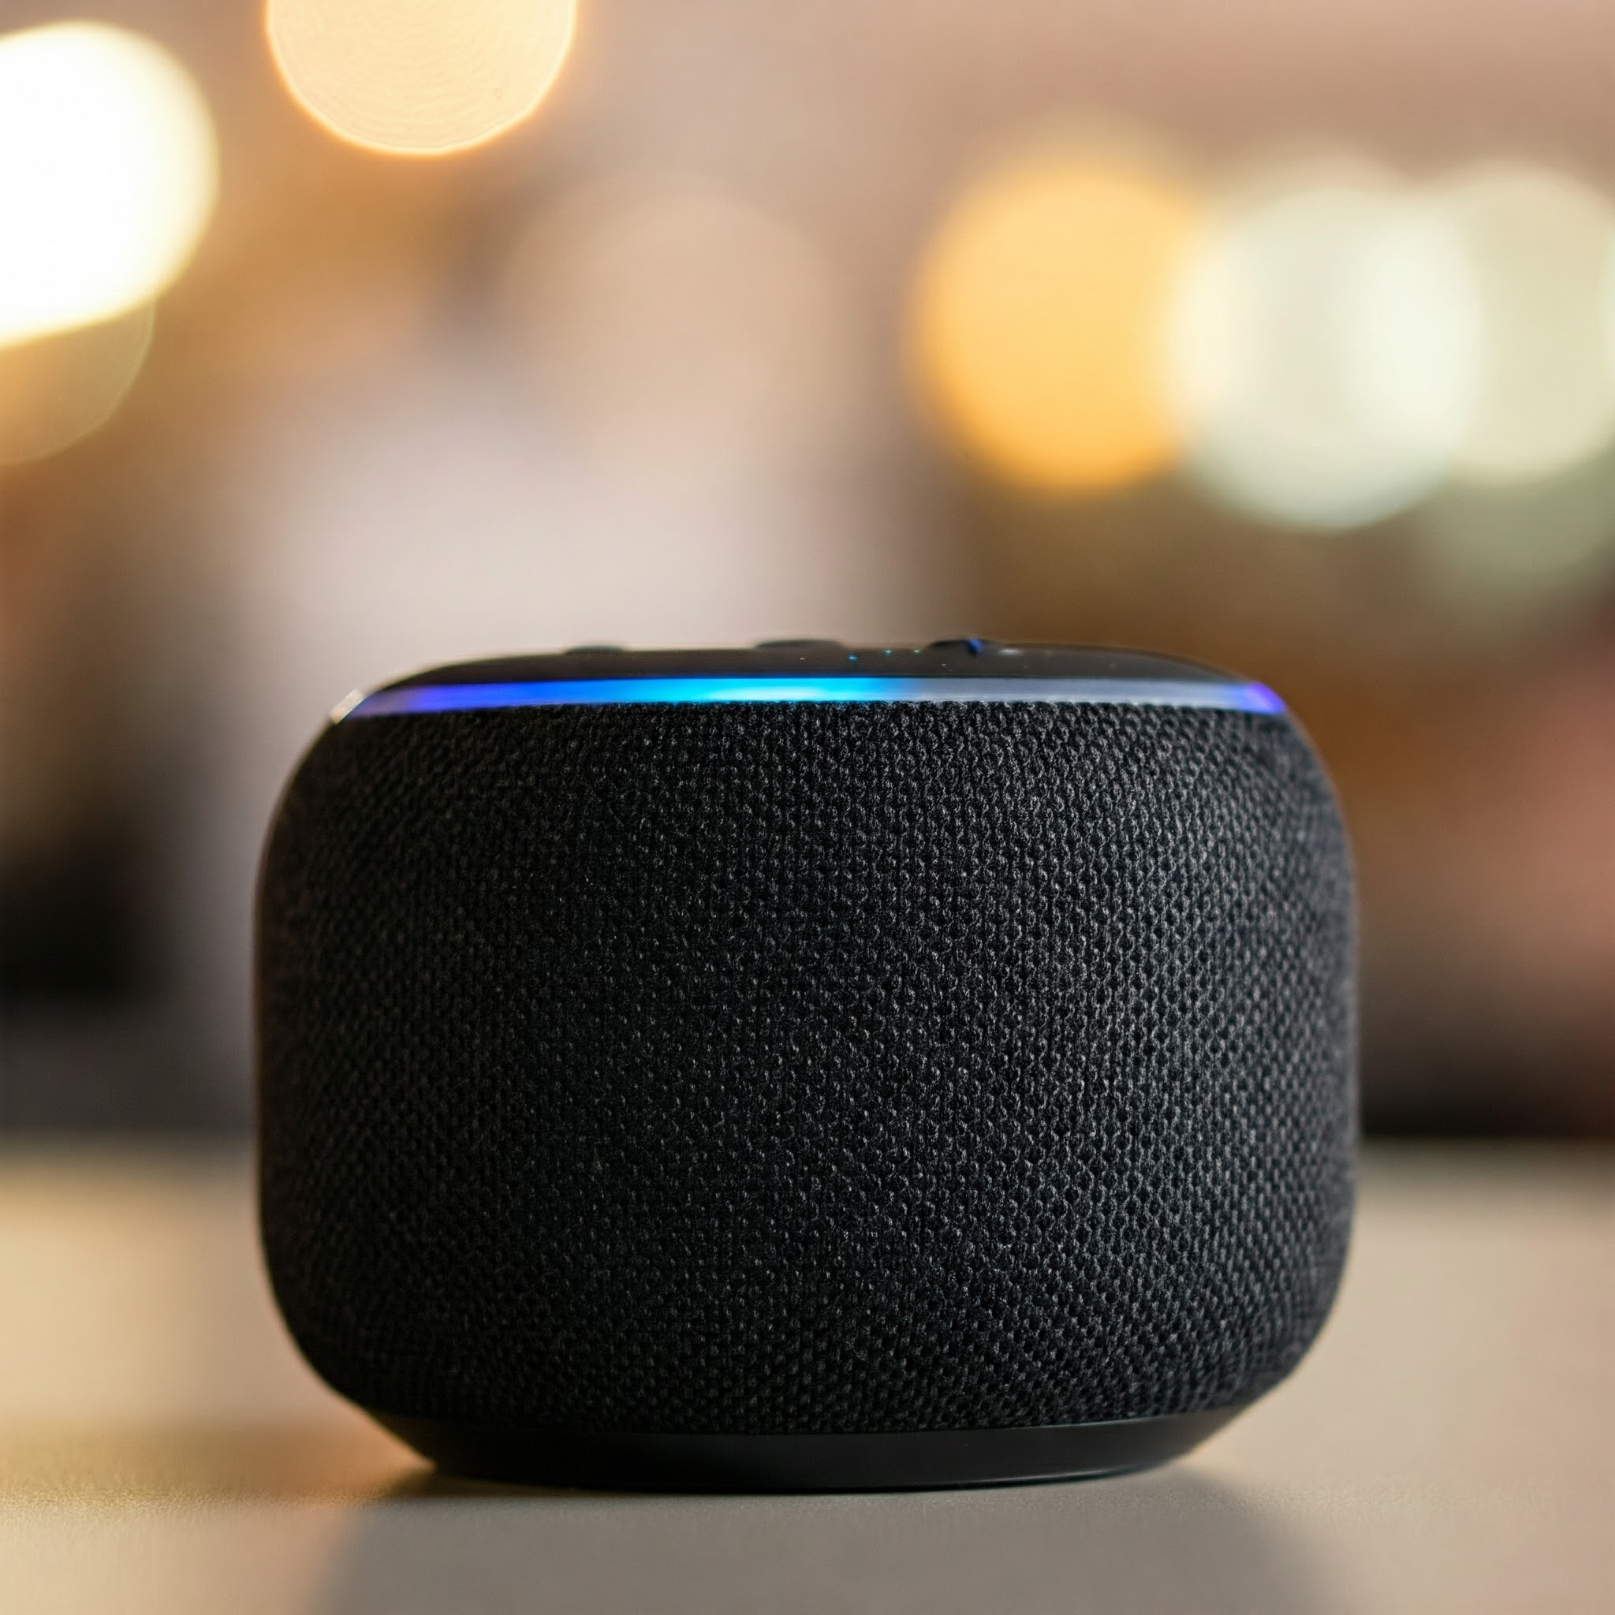

Hear
Digital signal processing
Speech recognition
Music search
Notes:
Another type of AI can use digital signal processing to hear and respond to vocal and audio inputs.
This type of AI is in smart speakers, like Google Home and Alexa, and the voice feature on mobile phones.
It’s also used in apps like Shazam, where it can listen to a song that it’s playing (eg on TV) and tell you the name of the song and the artist.

Slide 12

Create
Generative
Images
Video
Audio
Text
Image by Alan mWarburton
© BBC / Better Images of AI
Notes:
Generative AI is the thing that has really brought AI to the public’s attention over the last couple of years. It’s the umbrella term for the groundbreaking form of AI that can produce original content on-demand. Rather than simply analysing data, Generative AI tools can generate something entirely new, in text, image and audio and video forms, usually with just a few words of instruction. We call this instruction a prompt.
Images some artist are starting to use AI to create art and we see AI generated images in other places too like on social media and on websites, in brochures.
Generative AI is being used to create videos and some examples of this are educational videos where presenters can "speak" a range of different languages, or where long gone actors have been resurrected for film roles.
Text generation is where generative AI can have interesting real life applications for you and I for example in writing letters, asking it questions to help with coursework, creating social media posts, or making a cv and this is what we’re going to look at next.

Slide 13
Let’s try some Generative AI Tools
Notes:
There are lots of Generative AI tools. This area is changing at a fast pace so there are probably even more in development as we speak.
I’m going demonstrate just two of these tools today.

Slide 14
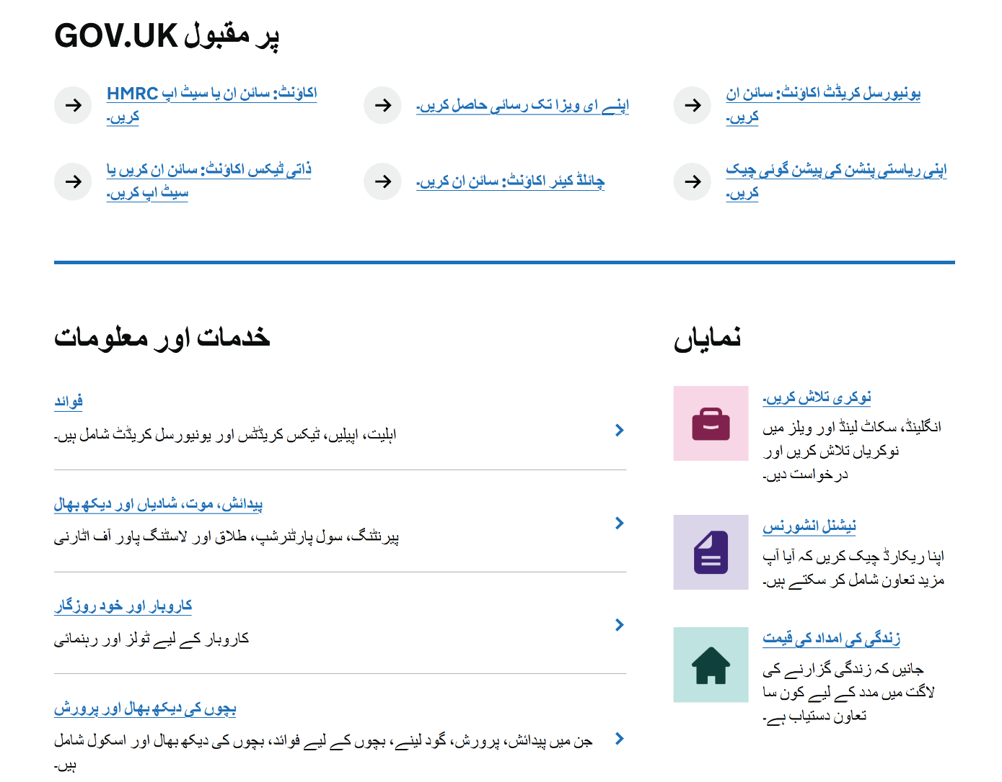
Google translate
Notes:
First let’s take a look at Google translate. This tool built into the Chrome browser and can translate any website into many languages.
Open any website in Chrome.
Select the three vertical dots in the top right corner of the window.
From the menu, select “Translate”.
The translation window (a small box) will open below the address bar.
Select the three vertical dots in the translation window.
Select “Choose another language…”
Use the drop down list to select the desired language, then select “Translate”.
You can switch between the original and translated versions using the translation window.

Slide 15
Text generators
Writing
  Draft letters, emails or social media posts
  Review for clarity, grammar and style
Planning
  Meels
  Budgets
  Fitness or workout routines
Practice
  Job interviews questions
Notes:
One type of generative AI tool called a text generator. Some examples of these you may have heard of are ChatGPT and Gemini.
These tools can hep with many things. Just a few examples are listed here.

Slide 16
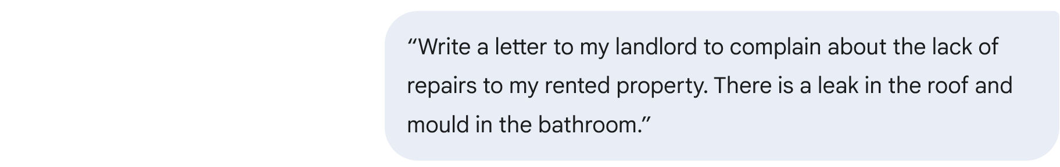

Writing a letter
Notes:
This is an example of using Gemini.
With just this simple prompt the tool gives us a great place to start from. It has:
a good format and structure
suggestions for details I may want to add to strengthen my complaint
help to formalise the action I want them to take
Try using a text generator to write a letter, meal plan or fitness routine.

Slide 17
Generative AI
Key Considerations
Notes:
As with most things in life, with generative AI there are both benefits and risks.
Next we’ll consider some key things that we need to be aware of about generative AI.

Slide 18

Bias
Gender
Race
Age
Health
Religion
Disability
Sexual orientation
Or other characteristics
Notes:
Generative AI tools are trained using large amounts of data or information which has often been sourced from the internet. This data may be unbalanced and/or reflect discrimination, societal biases and prejudices.
As a result, AI programs are more likely to generate content based on these prejudices. They may create discriminatory content when it comes to gender, race, age, health, religion, disability, sexual orientation or other characteristics.
For example, asking and AI tool to create a photo realistic image of a librarian resulted in a picture of a white older female. This is understandable but probably not completely representative of librarians today.

Slide 19

Plagiarism and copyright
Generative AI tools attempt to create original content, which may closely represent or even copy existing works.
Notes:
Plagiarism is presenting someone’s work as your own and copyright infringement is using copyrighted material without permission from the owner.
Because generative AI programs aggregate and analyse text from the internet, whilst they attempt to create original content, it may actually closely represent or even copy existing works.
For example, a generated covering letter for a job application might use the exact words from an existing letter on the internet.
Or an image created for a poster could use part of an artist's work without their knowledge. Like here, where the mona lisa has been used in a generated advert to promote a range of beauty products.

Slide 20
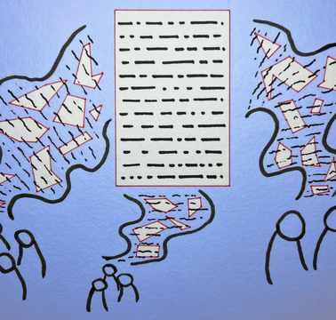
Quality control
Generative AI tools collect information from the internet and create new content based on it.
They don't understand the text they create.
This could result in grammatical or factual errors, or even insensitive content.
Image by Yasmine Boudiaf & LOTI
Better Images of AI
Notes:
AI text generators don't understand the text they create. It’s a bit like someone knowing how to write words in a foreign language but not knowing what they actually mean. This could result in grammatical or factual errors, or even insensitive content. And it often uses US spelling (eg replacing ‘s’ with ‘z’).
Recently Google had to re-edit an advert that was shown during the Super Bowl (a high profile American sporting event). It showed a cheese maker using Gemini to write a product description. In the advert Gemini showed stated that Gouda accounts for 50% to 60% of cheese eaten across the world. This isn’t true; the Gemini had made this up, and experts were quick to point this out to Google.
Similarly in May 2024 the AI search in Chrome was criticised after if told some users to use non toxic glue when they asked how to make cheese stick to pizza. It didn’t understand the context of the search so it’s answer was unsurprisingly inappropriate.
Generative AI tools can help you to get started with a tasks quickly but the outputs always need human input to review them, make sure they are correct and make sense.

Slide 21
Key takeaways
Generative AI tools give us a great starting point and can help save time.
Just like humans, Generative AI tools can make mistakes and errors.
Human intelligence is always needed to check what Generative AI tools create.

Slide 22
Thank you
goodthingsfoundation.tfaforms.net/254
Notes:
I hope you’ve found some of what’s been covered interesting and helpful.
Please return to the survey from the start and answer the questions 2 and 3.
goodthingsfoundation.tfaforms.net/254

